Slide 1
Lecture 5: Advanced SQL Concepts
COMP / IT 420 Spring 2021
Monday February 22nd, 2021

Slide 2
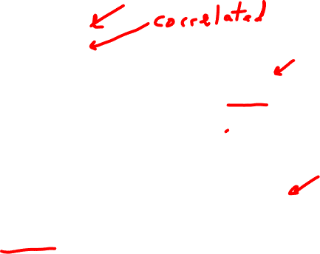
Today’s SQL Menu
Lab 3 Notes
Views (Virtual Tables)
Common Table Expressions (CTEs)
Stored Procedures
Functions
Triggers
Group Project Assignment Overview
In-class Exercise

Slide 3

Lab and Grading Notes
Lab 2 is graded and returned
Lab 3 is 50% graded
Grading is now on in Canvas
Grade Reports out last week

Slide 4

Lab 3 Review
Some issues with entity integrity and foreign keys.
Some screenshot submission issues.

Slide 5
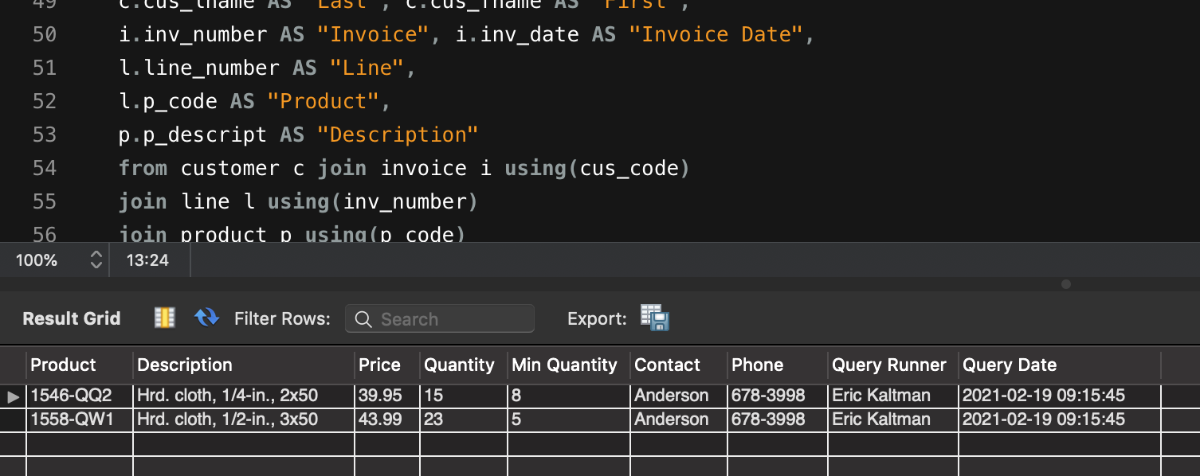

Query top and / or bottom is cut off

Slide 6
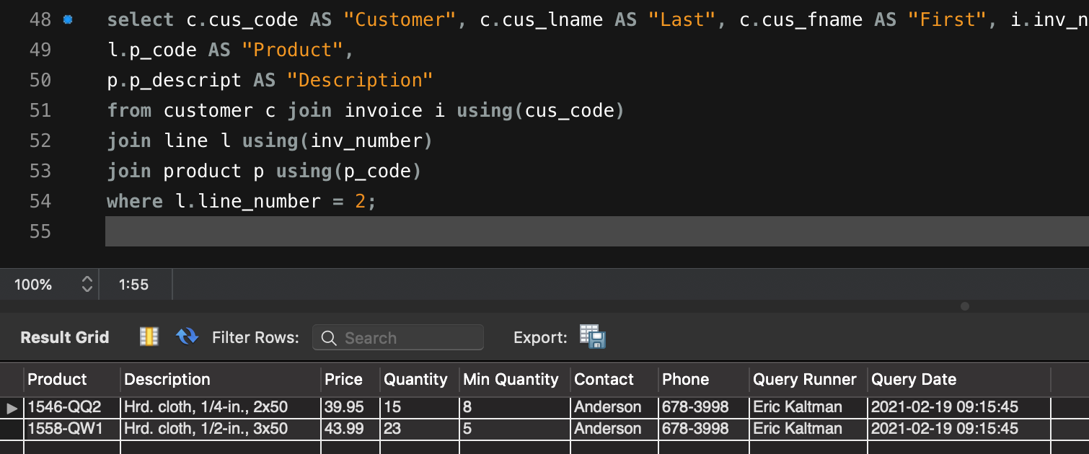

Query is cut off on the right side

Slide 7
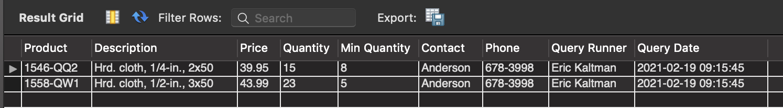

Query missing will give basically no credit.

Slide 8
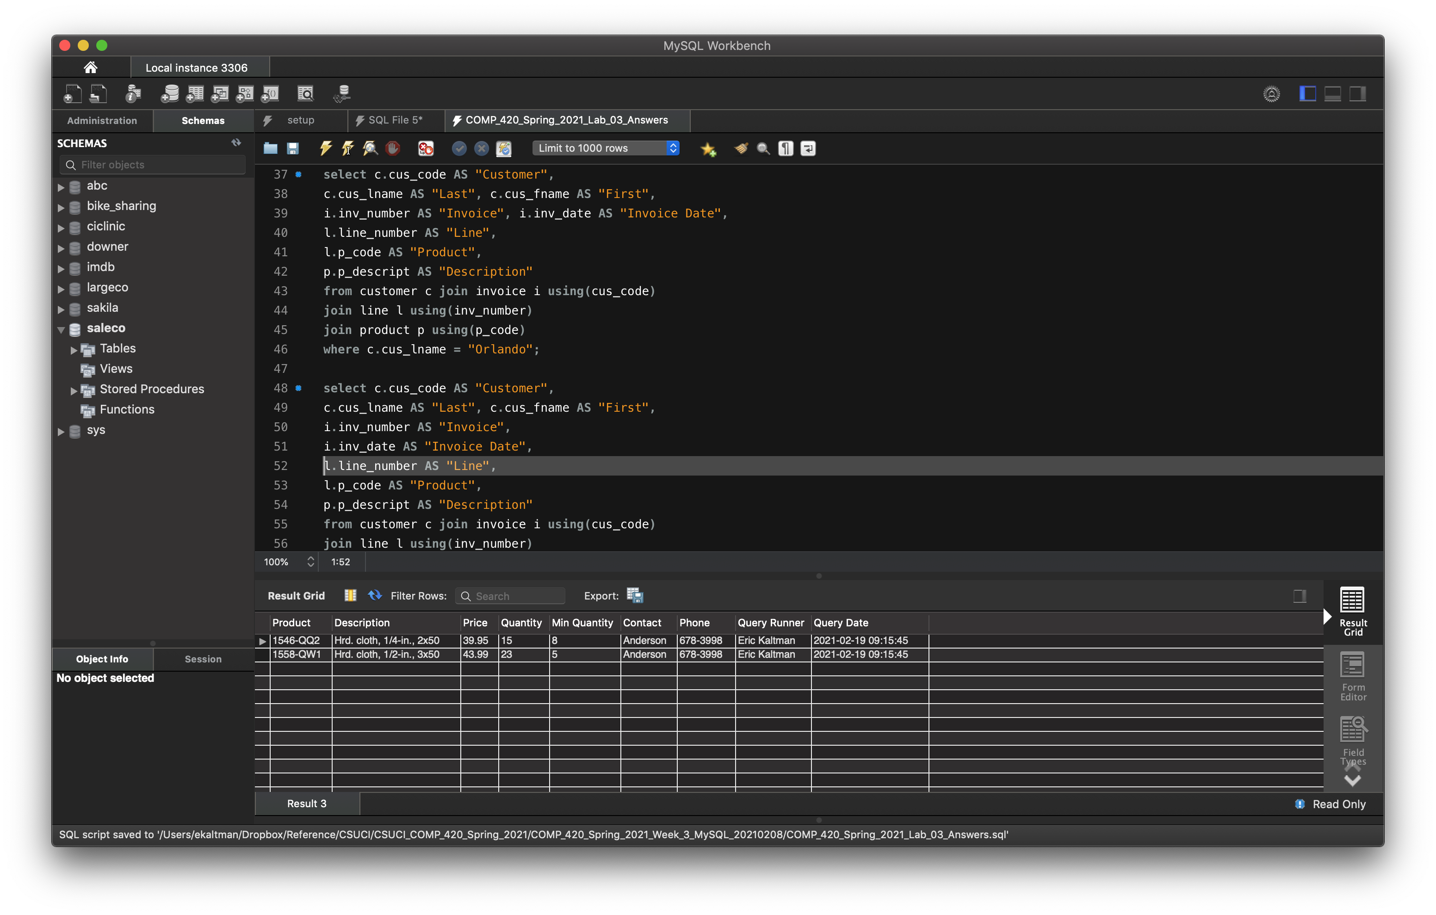

Slide 9
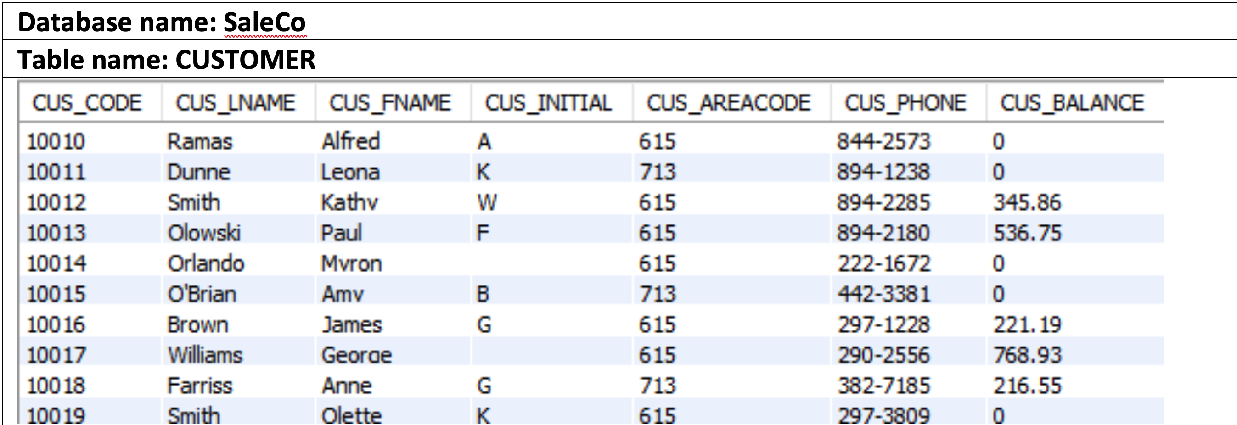
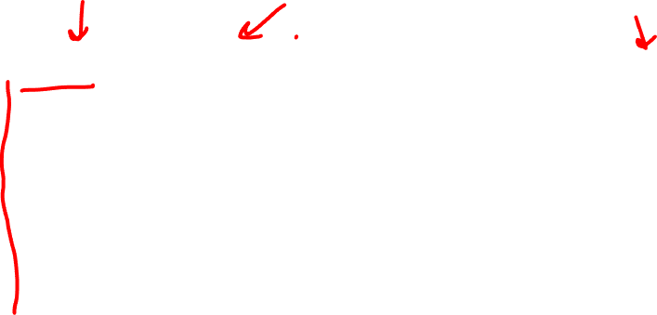
Keys and Integrity

Slide 10
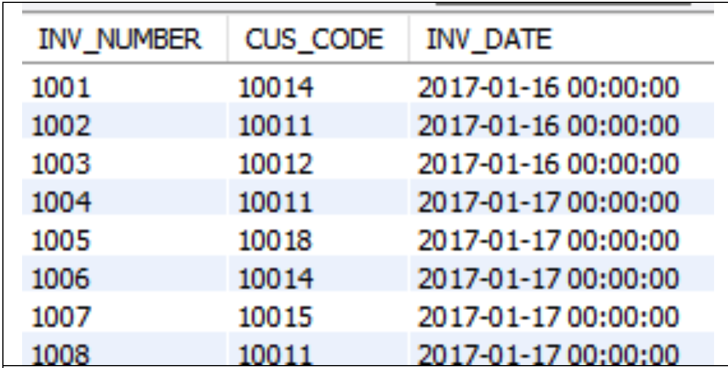
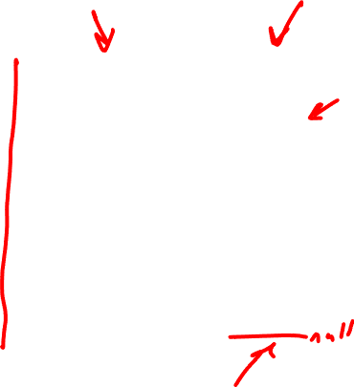

Slide 11
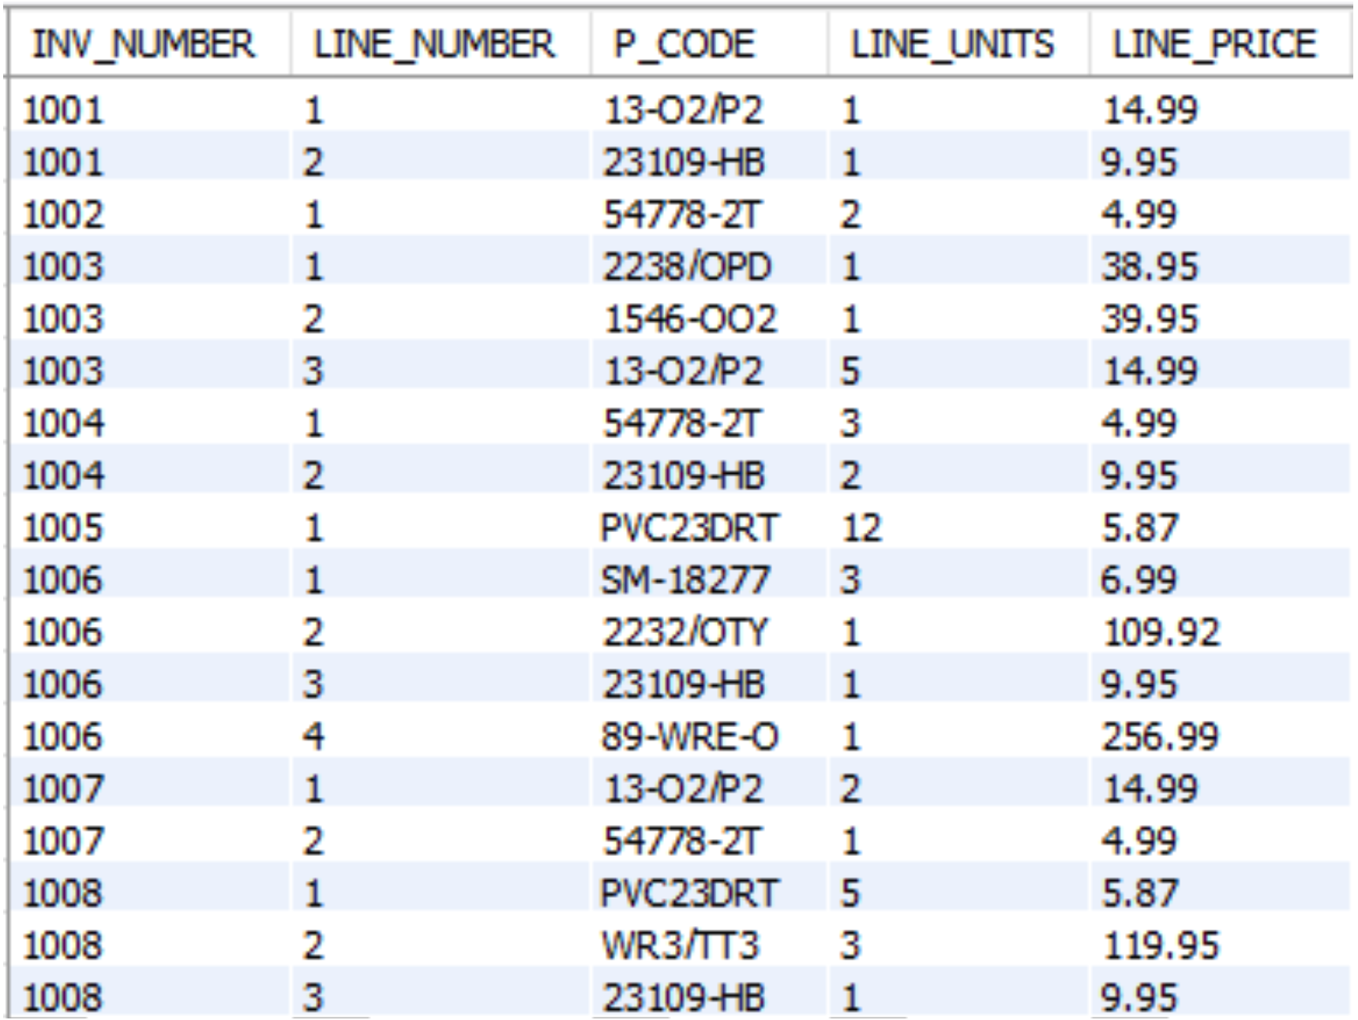


Slide 12

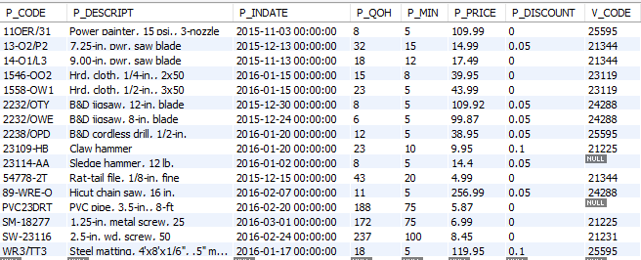

Slide 13
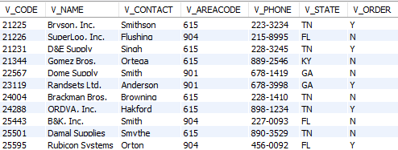

Slide 14
On to today’s content
But first, back to correlated queries…

Slide 15
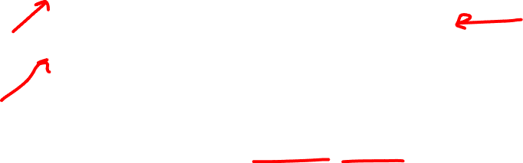
Correlated Sub-Queries
Inner query which executes once for each row of the outer query
Similar to a ”for” loop in a procedural language
FOR X = 1 TO 2
FOR Y = 1 TO 3
PRINT “X =“ X, ”Y=“ Y
X = 1 Y=1
X = 2 Y=1
X = 1 Y=2
X = 2 Y=2
X = 1 Y=3
X = 2 Y=3

Slide 16
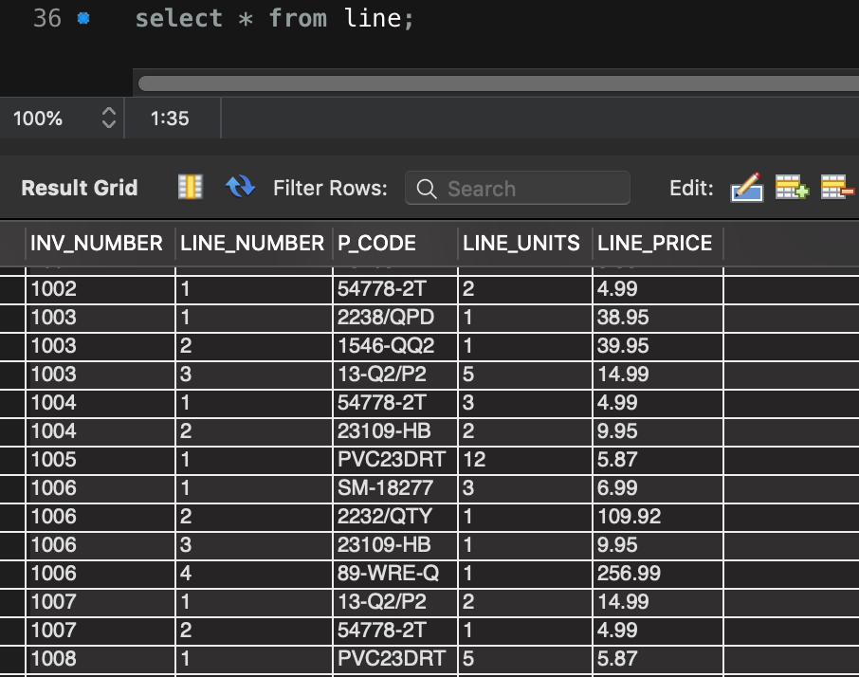

Line Table

Slide 17
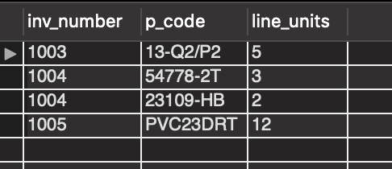
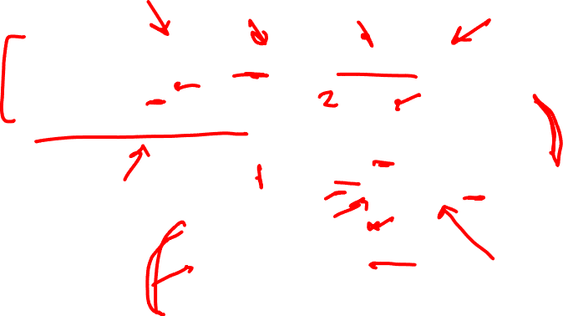
Units Sold Greater Than Average Per Unit
SELECT inv_number, p_code, line_units
FROM line ls
WHERE ls.line_units > (SELECT AVG(line_units)
FROM line la
WHERE la.p_code = ls.p_code);

Slide 18
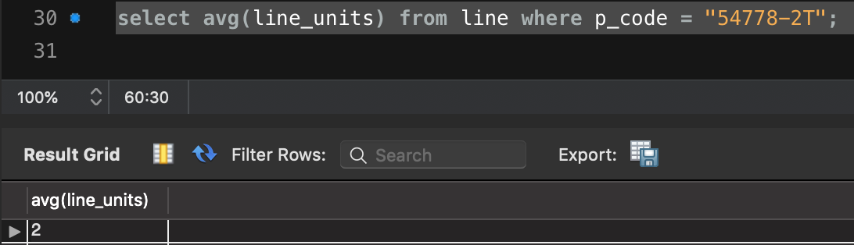
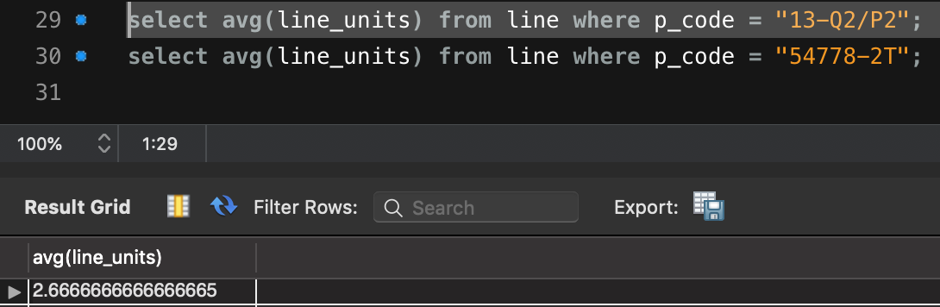
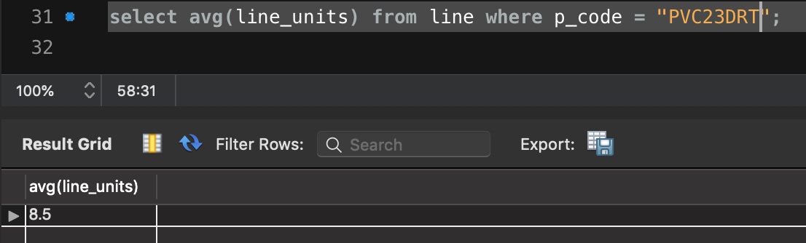
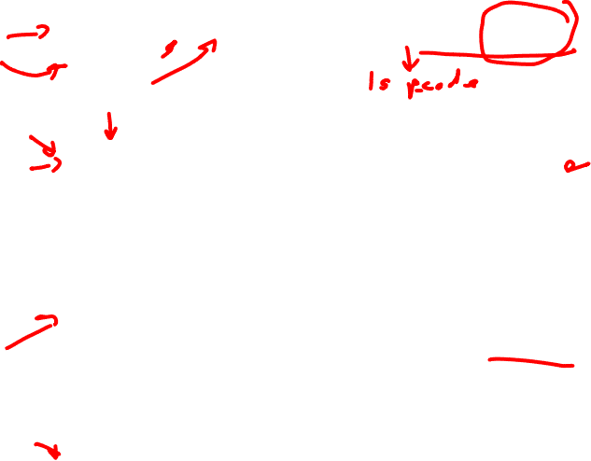

Slide 19

Views (or Virtual Tables)
View: Virtual table based on a SELECT query
Base tables: Tables on which the view is based
A view is a permanent database object
CREATE VIEW statement: Data definition command that stores the subquery specification in the data dictionary
CREATE VIEW viewname AS SELECT query

Slide 20
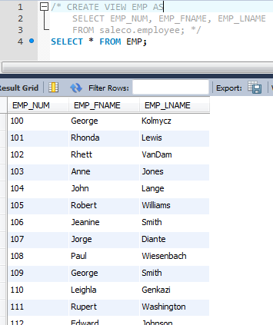
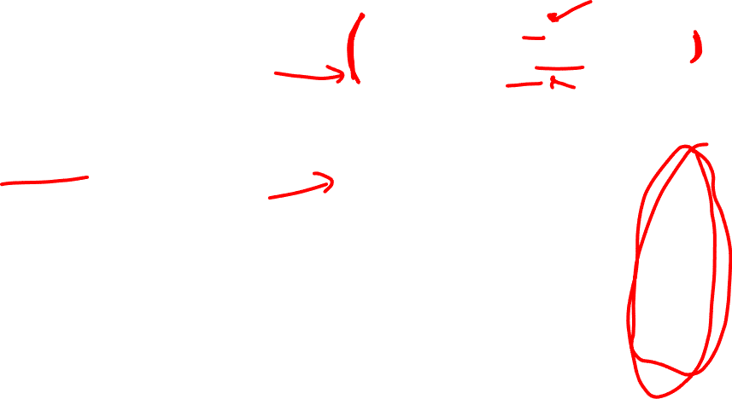
Create a limited table based on a
larger table.
What is going on here?
Why would using a view be advantageous in general?

Slide 21
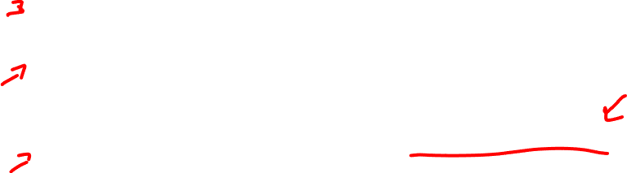
Why use Views?
Limited data presentation to specific users. (Security)
Base table may be too large for effective use. (Optimization)
Common usage in the database means that caching through views is useful. (Optimization)

Slide 22
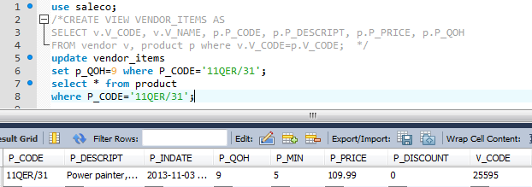
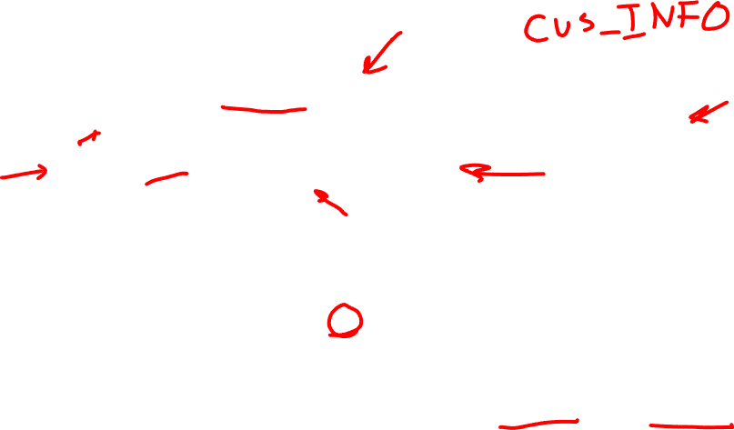
Updatable View
UPDATE, INSERT and DELETE will propagate from a view
to the base table under specific conditions.
Mainly, if there is a one-to-one correspondence between the VIEW’s rows and the base table’s

Slide 23
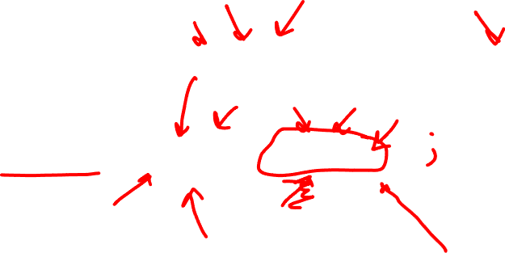
Quiz View
Create a view named “CUS_INFO” that contains only a customers first name, initial, and last name (in that column order).
CREATE VIEW _______ AS _________

Slide 24

Common Table Expressions (CTEs)
New to MySQL
Temporary table definition, usable in many places
May be easier to read than a table sub-query
Can be recursive to traverse hierarchical data using RECURSIVE
Break larger queries into more manageable chunks with WITH command

Slide 25
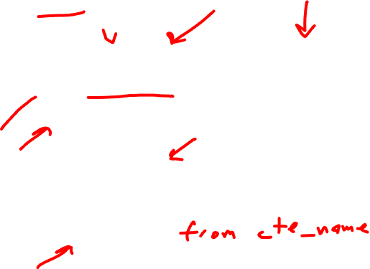
CTE Syntax
WITH cte_name [(col1, col2, ...)]
AS (sub_query), ...
SQL statement;
WITH cte_name [(col1, col2, ...)]
AS (sub_query), ...
SELECT ...;

Slide 26
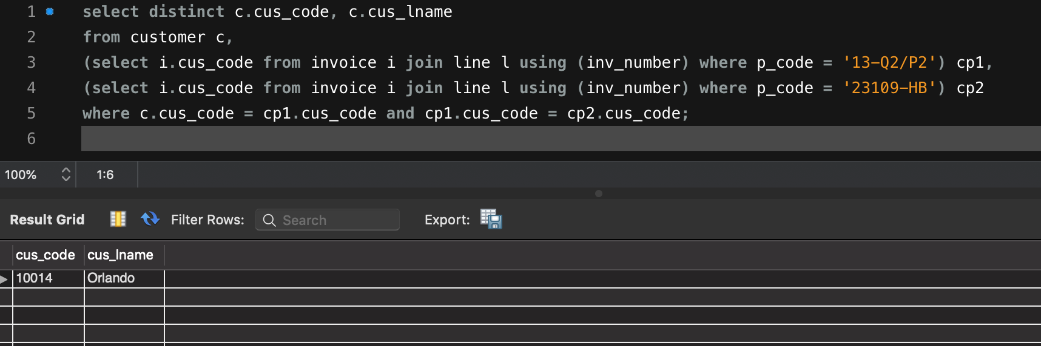
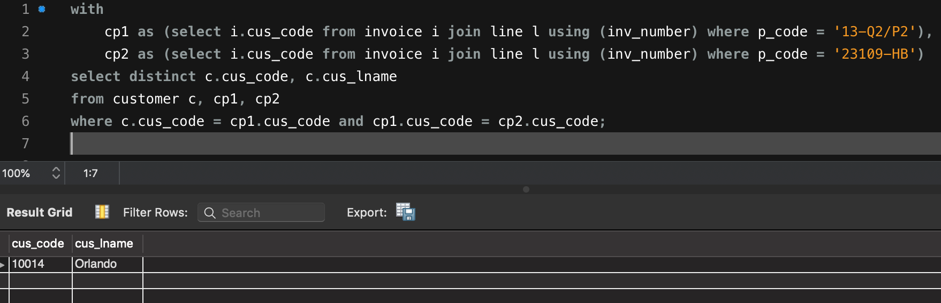

Subquery
CTE

Slide 27
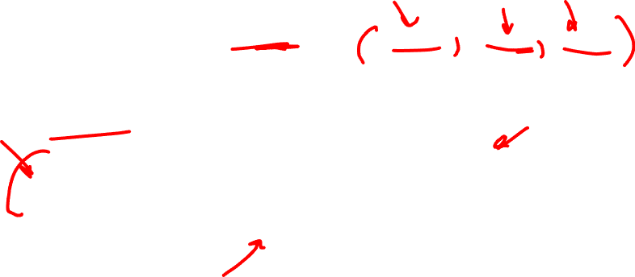
RECURSIVE CTE
WITH RECURSIVE
cte_name AS (
initial_query -- anchor member
UNION ALL
recursive_query -- recursive member that references to the CTE name
)
SELECT * FROM cte_name;

Slide 28
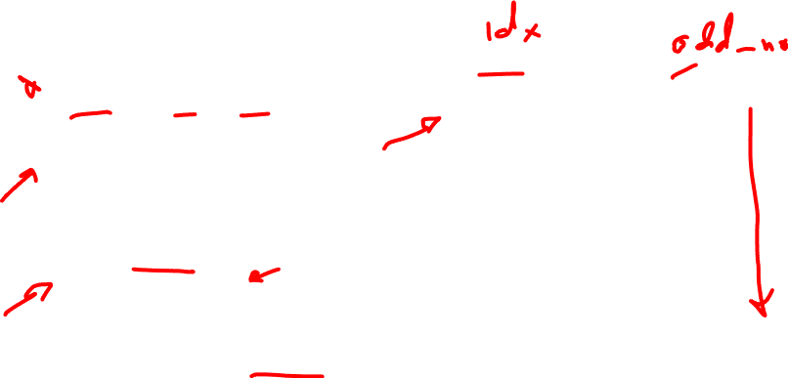
What does this do?
WITH RECURSIVE
odd_no (idx, odd) AS
(
SELECT 1, 1
union all
SELECT idx+1, odd+2
FROM odd_no
WHERE idx < 5
)
SELECT * FROM odd_no;
sr_no | n
1 | 1
2 | 3
3 | 5
4 | 7
5 | 9

Slide 29

Stored Procedures and Defined Functions
Procedure
Named collection of SQL statements
User Defined Functions
Returns based on input
Advantages
Reduce network traffic and increase performance
Reduce code duplication by means of code isolation and code sharing

Slide 30

Stored Procedure Syntax
DELIMITER delimiter_characters
CREATE PROCEDURE procedure_name ([IN] parameter_1, parameter_2)
BEGIN
…SQL statements;
END delimiter_characters
DELIMITER ;

Slide 31
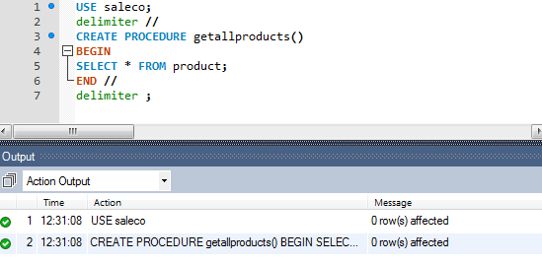
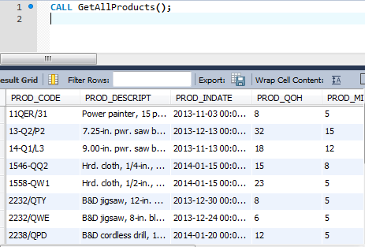

Stored Procedure Example

Slide 32
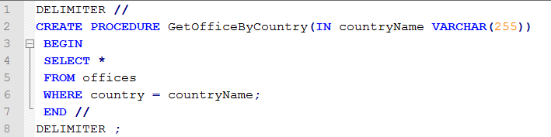

Stored Procedure Example (2)
Parameter
Arguments
CALL GetOfficeByCountry('USA')

Slide 33
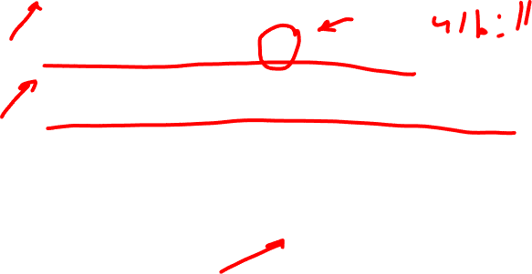
Variable declaration in Procedures
DECLARE variable_1, variable_2 datatype [DEFAULT default_value];
DECLARE totalInvoices INT DEFAULT = 0;
DECLARE totalInvoices, totalLines INT DEFAULT = 0;
Can declare multiple variables in one statement if they are the same datatype.
Variable scope is valid inside BEGIN…END where declaration is made.

Slide 34

Variable assignment in procedures
SET command
SET totalInvoices = 10;
SELECT … INTO variable FROM table;
SELECT count(*) INTO totalInvoices FROM invoices;
SET is a direct declaration, SELECT INTO pull information from database.

Slide 35

SET @variable_name
There are multiple potential scopes for a variable SET declaration:
SET variable_name inside a procedure
SET @variable_name inside a session
SET GLOBAL or @@GLOBAL.variable_name for global

Slide 36

Procedural SQL (PL/SQL and T-SQL)
Oracle, PostgreSQL, MySQL, MSSQL all have different implementations
Merging of SQL and traditional programming constructs
Provides conditional or looping operations
Shared code for better maintenance and control
Persistent stored module (PSM): Block of code containing:
Standard SQL statements
Procedural extensions that is stored and executed at the DBMS server

Slide 37

Procedural SQL
Procedural Language SQL (PL/SQL)
Use and storage of procedural code and SQL statements within the database
Procedural code is executed as a unit by DBMS when invoked by end user
End users can use PL/SQL to create:
Anonymous PL/SQL blocks and triggers
Stored procedures and PL/SQL functions

Slide 38
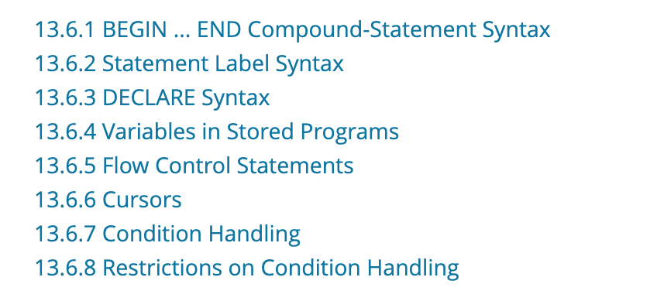

MySQL 8.x Compound Statement
https://dev.mysql.com/doc/refman/8.0/en/sql-compound-statements.html

Slide 39
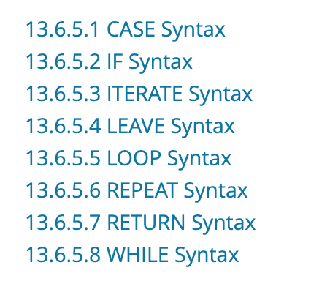

MySQL 8.x Compound Statement

Slide 40
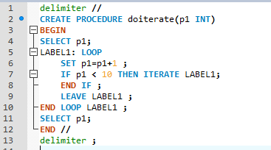
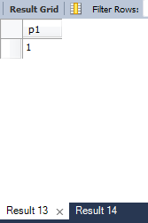
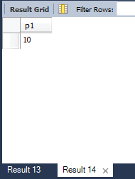
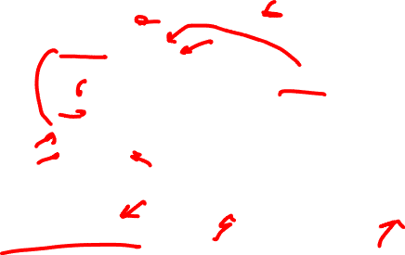
Procedure Example (MySQL)
Query 1
Query 2
call doiterate(1);

Slide 41

User Defined (Stored) Function Syntax
DELIMITER $$
CREATE FUNCTION function_name(param1, param2,…)
RETURNS datatype
[NOT] DETERMINISTIC
BEGIN
-- statements
END $$
DELIMITER ;

Slide 42
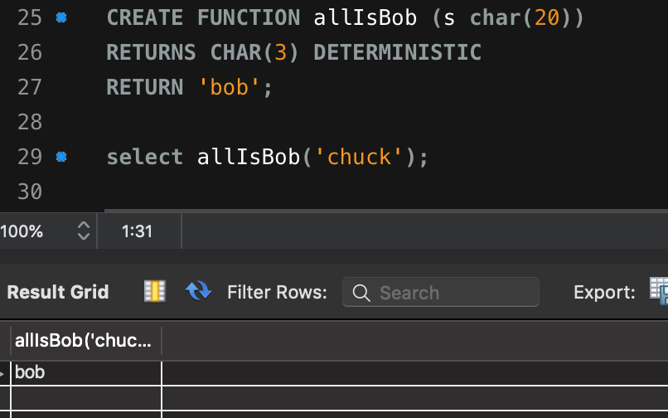
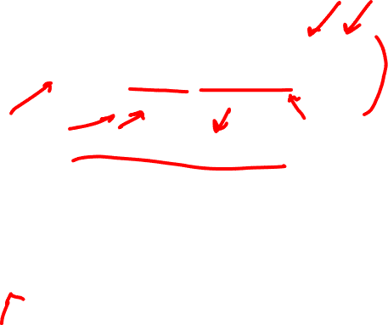
Function Example (MySQL)

Slide 43
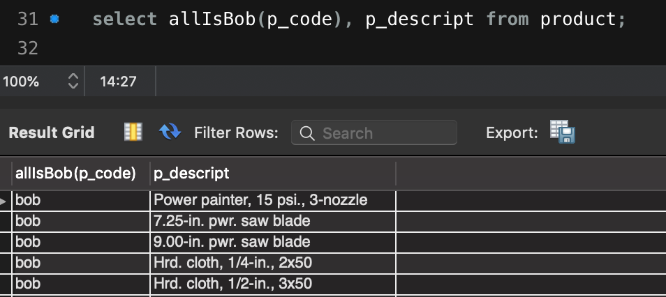

Functional Example (MySQL)

Slide 44
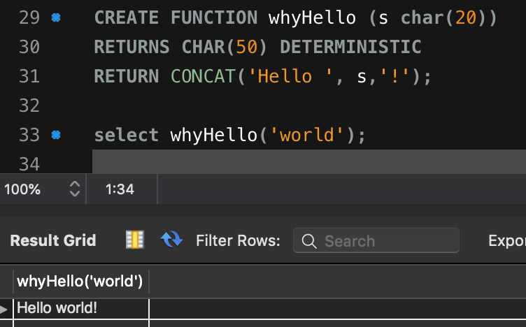

Functional Example (MySQL)

Slide 45
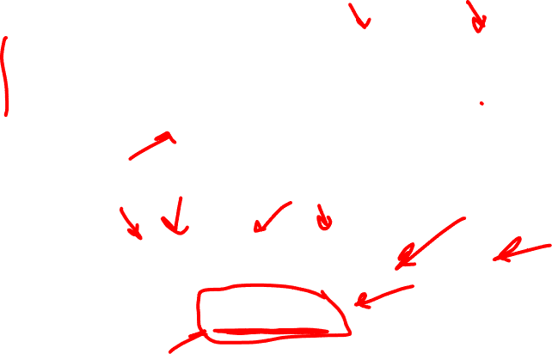
Quiz Function
CREATE FUNCTION pTotals (num int, price float)
RETURNS float DETERMINISTIC
RETURNS num * price;
What value would the following statement return based on the above function declaration?
SELECT pTotals(p_qoh, p_price)
FROM product
WHERE p_code = “14-Q1/L3”;

Slide 46
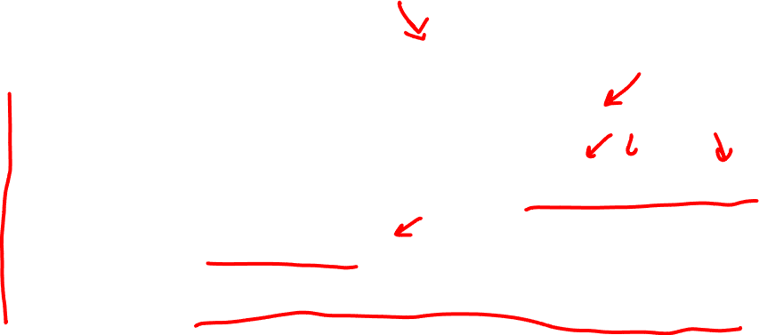
Triggers
SQL code that is invoked (triggered) when a DML event occurs
Triggering timing - Indicates when trigger’s PL/SQL code executes
Triggering event - Statement that causes trigger execution (UPDATE, INSERT, DELETE)
Triggering level - Statement- and row-level
Triggering action - PL/SQL code enclosed between the BEGIN and END keywords

Slide 47

Triggers
DROP TRIGGER trigger_name command
Deletes a trigger without deleting the table
Trigger action based on DML predicates
Actions depend on the type of DML statement that fires the trigger

Slide 48
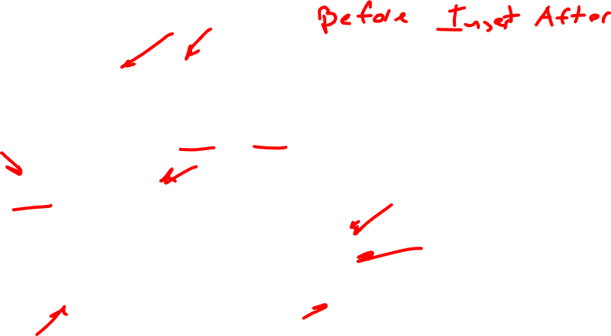
Triggers
BEFORE and AFTER triggers
Both triggers will fire on triggering statement
Manipulation occurs before or after triggering statement operation
NEW and OLD
States of values to change in trigger body
NEW values on INSERT and UPDATE
OLD values on UPDATE and DELETE
OLD is read-only (since it is being modified by the triggering statement)

Slide 49
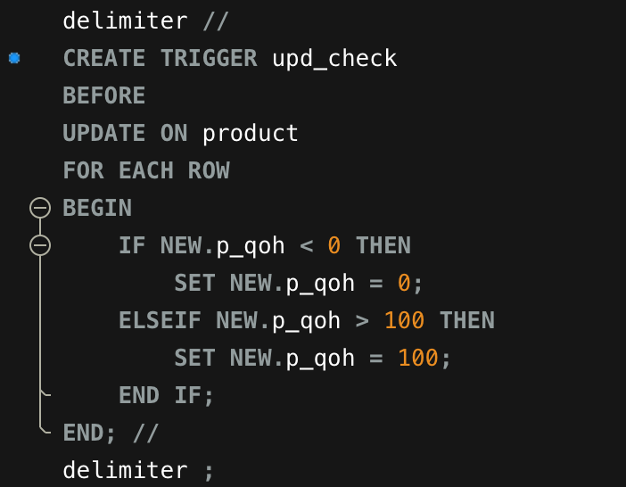
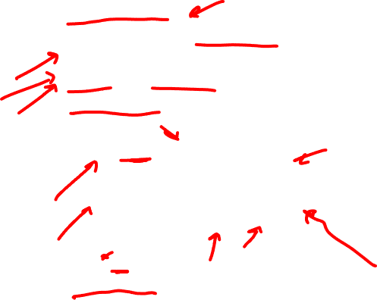
Trigger Example (1)
Triggering Timing
Triggering Event
Triggering Level
Triggering Statement

Slide 50



Trigger Example (2)

Slide 51

Quiz Trigger
DELIMITER //
CREATE TRIGGER ins_check
BEFORE
INSERT ON product
FOR EACH ROW
BEGIN
DECLARE max_price int;
SELECT max(p_price) INTO max_price from product;
IF NEW.p_price < max_price:
NEW.p_price = max_price + 10;
END //
Please identify the triggering timing, and event.
What is the triggering statement doing?
DO NOT identify the triggering timing.

Slide 52
Database Assignment Part 2
Next assignment is due Tuesday, March 23rd at 11:59pm.
Database summary and initial design document of at least two pages.
Should outline your problem domain and solution thoroughly.

Slide 53
Database Assignment Part 2
Database domain and business problem or need (at least 300 words)
At least eight (8) primary entities named, with a description of how they relate to the proposed solution
Data sources that you plan on using to populate your database. If you are generating your own data, how do you plan on doing that?
At least eight (8) business rules governing the relationships between your entities.
Sample queries, reports or views business users will run against your database
Two sample queries you expect users to run on the database
Three reports you plan on generating for your users, including how those reports relate to your use case
Three views you plan on constructing for your users, this must include at least one view for a specific user class for security purposes

Slide 54
Database Assignment Part 3
Milestone A: (90 pts) Use Draw.io to construct the data model (in ERD Crow's Foot notation) for your planned database and submit it to Canvas. Your data model represents the blueprint for construction, so a well-designed design will get you moving in the right direction. Your data model will consist of:
Entities (75% of all entities to be included in your final DB) (20 pts)
Attributes (all primary attributes needed to showcase entity and relational integrity) (25pts)
Primary Keys (10pts)
Foreign Keys (15pts)
Connectivity (proper Crows Foot notation) (15pts)
Cardinality (5 pts)

Slide 55
Database Assignment Part 3
Milestone B: (45 pts) Submit a one-page description of how your database will link to a functioning system and outline the technical implementation of said system. You will need to outline:
Chosen programming language and database connector (5pts)
Chosen GUI framework (5pts)
How are your system and database integrated? (10pts)
What features does your system provide that would not be possible with just a database? (10pts)
Sketch of a basic UI design (10 pts)
Sketch of an insertion, modification, and deletion operation (15pts)

Slide 56
In-Class Assignment
Using the bike sharing dataset, please work together to describe:
Two procedures
Two views
A function
A trigger
There is more information on Canvas, please write up your own descriptions after working with your team.

Slide 57

Two procedures
Two views
A function
A trigger

